Slide 1



ML/DL for Everyone with
Lecture 8:
DataLoader
Sung Kim <hunkim+ml@gmail.com> HKUST
Code: https://github.com/hunkim/PyTorchZeroToAll
Slides: http://bit.ly/PyTorchZeroAll
Videos: http://bit.ly/PyTorchVideo

Slide 2

Call for Comments
Please feel free to add comments directly on these slides.
Other slides: http://bit.ly/PyTorchZeroAll
Picture from http://www.tssablog.org/archives/3280

Slide 3
ML/DL for Everyone with
Lecture 8:
DataLoader
Sung Kim <hunkim+ml@gmail.com> HKUST
Code: https://github.com/hunkim/PyTorchZeroToAll
Slides: http://bit.ly/PyTorchZeroAll
Videos: http://bit.ly/PyTorchVideo

Slide 4

Manual data feed
xy = np.loadtxt('data-diabetes.csv', delimiter=',', dtype=np.float32)
x_data = Variable(torch.from_numpy(xy[:, 0:-1]))
y_data = Variable(torch.from_numpy(xy[:, [-1]]))
...
# Training loop
for epoch in range(100):
# Forward pass: Compute predicted y by passing x to the model
y_pred = model(x_data)
# Compute and print loss
loss = criterion(y_pred, y_data)
print(epoch, loss.data[0])
# Zero gradients, perform a backward pass, and update the weights.
optimizer.zero_grad()
loss.backward()
optimizer.step()

Slide 5
Batch (batch size)
# Training cycle
for epoch in range(training_epochs):
# Loop over all batches
for i in range(total_batch):
batch_xs, batch_ys = …

Slide 6
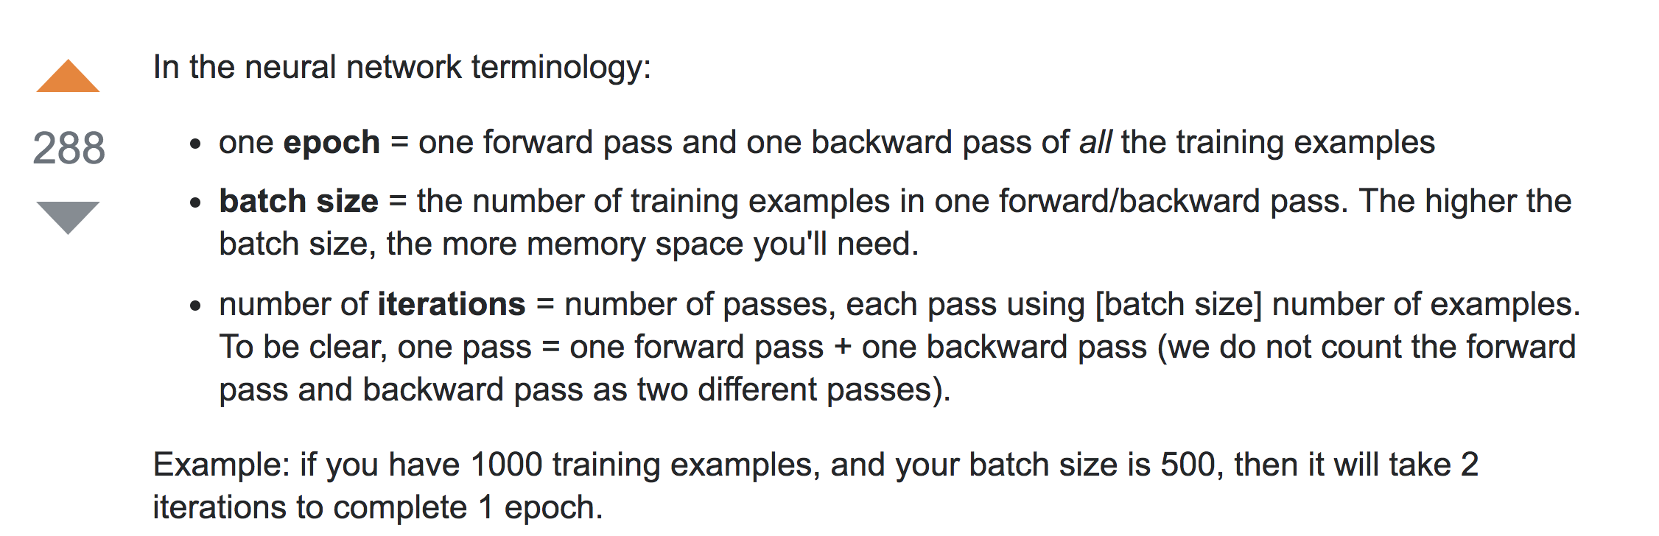
Batch (batch size)
# Training cycle
for epoch in range(training_epochs):
# Loop over all batches
for i in range(total_batch):
batch_xs, batch_ys = …
https://stackoverflow.com/questions/4752626

Slide 7
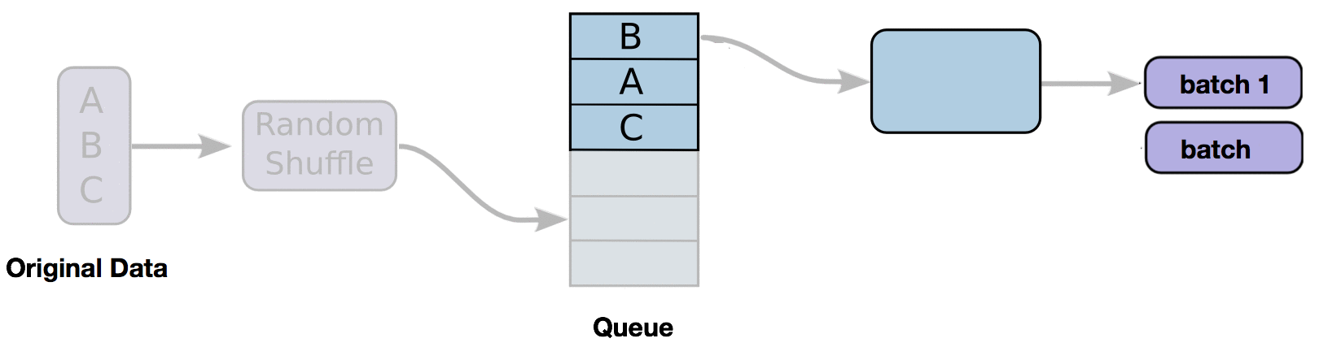
DataLoader
iterable
2
for i, data in enumerate(train_loader, 0):
# get the inputs
inputs, labels = data
# wrap them in Variable
inputs, labels = Variable(inputs), Variable(labels)
# Run your training process
print(epoch, i, "inputs", inputs.data, "labels", labels.data)

Slide 8



Custom DataLoader
class DiabetesDataset(Dataset):
""" Diabetes dataset."""
# Initialize your data, download, etc.
def __init__(self):
xy = np.loadtxt('data-diabetes.csv', delimiter=',', dtype=np.float32)
self.len = xy.shape[0]
self.x_data = torch.from_numpy(xy[:, 0:-1])
self.y_data = torch.from_numpy(xy[:, [-1]])
def __getitem__(self, index):
return self.x_data[index], self.y_data[index]
def __len__(self):
return self.len
dataset = DiabetesDataset()
train_loader = DataLoader(dataset=dataset,
batch_size=32,
shuffle=True,
num_workers=2)
download, read data, etc.
return one item on the index
return the data length
https://github.com/yunjey/pytorch-tutorial

Slide 9
Custom DataLoader
class DiabetesDataset(Dataset):
""" Diabetes dataset."""
# Initialize your data, download, etc.
def __init__(self):
xy = np.loadtxt('data-diabetes.csv', delimiter=',', dtype=np.float32)
self.len = xy.shape[0]
self.x_data = torch.from_numpy(xy[:, 0:-1])
self.y_data = torch.from_numpy(xy[:, [-1]])
def __getitem__(self, index):
return self.x_data[index], self.y_data[index]
def __len__(self):
return self.len
dataset = DiabetesDataset()
train_loader = DataLoader(dataset=dataset,
batch_size=32,
shuffle=True,
num_workers=2)

Slide 10
Using DataLoader
dataset = DiabetesDataset()
train_loader = DataLoader(dataset=dataset, batch_size=32, shuffle=True, num_workers=2)
# Training loop
for epoch in range(2):
for i, data in enumerate(train_loader, 0):
# get the inputs
inputs, labels = data
# wrap them in Variable
inputs, labels = Variable(inputs), Variable(labels)
# Forward pass: Compute predicted y by passing x to the model
y_pred = model(inputs)
# Compute and print loss
loss = criterion(y_pred, labels)
print(epoch, i, loss.data[0])
# Zero gradients, perform a backward pass, and update the weights.
optimizer.zero_grad()
loss.backward()
optimizer.step()

Slide 11

Classifying Diabetes
class Model(torch.nn.Module):
def __init__(self):
"""
In the constructor we instantiate two nn.Linear module
"""
super(Model, self).__init__()
self.l1 = torch.nn.Linear(8, 6)
self.l2 = torch.nn.Linear(6, 4)
self.l3 = torch.nn.Linear(4, 1)
self.sigmoid = torch.nn.Sigmoid()
def forward(self, x):
"""
In the forward function we accept a Variable of input data and we must return
a Variable of output data. We can use Modules defined in the constructor as
well as arbitrary operators on Variables.
"""
out1 = self.sigmoid(self.l1(x))
out2 = self.sigmoid(self.l2(out1))
y_pred = self.sigmoid(self.l3(out2))
return y_pred
# our model
model = Model()
# Construct our loss function and an Optimizer. The call to model.parameters()
# in the SGD constructor will contain the learnable parameters of the two
# nn.Linear modules which are members of the model.
criterion = torch.nn.BCELoss(size_average=True)
optimizer = torch.optim.SGD(model.parameters(), lr=0.1)
# Training loop
for epoch in range(2):
for i, data in enumerate(train_loader, 0):
# get the inputs
inputs, labels = data
# wrap them in Variable
inputs, labels = Variable(inputs), Variable(labels)
# Forward pass: Compute predicted y by passing x to the model
y_pred = model(inputs)
# Compute and print loss
loss = criterion(y_pred, labels)
print(epoch, i, loss.data[0])
# Zero gradients, perform a backward pass, and update the weights.
optimizer.zero_grad()
loss.backward()
optimizer.step()
# References
# https://github.com/yunjey/pytorch-tutorial/blob/master/tutorials/01-basics/pytorch_basics/main.py
# http://pytorch.org/tutorials/beginner/data_loading_tutorial.html#dataset-class
import torch
import numpy as np
from torch.autograd import Variable
from torch.utils.data import Dataset, DataLoader
class DiabetesDataset(Dataset):
""" Diabetes dataset."""
# Initialize your data, download, etc.
def __init__(self):
xy = np.loadtxt('data-diabetes.csv', delimiter=',', dtype=np.float32)
self.len = xy.shape[0]
self.x_data = torch.from_numpy(xy[:, 0:-1])
self.y_data = torch.from_numpy(xy[:, [-1]])
def __getitem__(self, index):
return self.x_data[index], self.y_data[index]
def __len__(self):
return self.len
dataset = DiabetesDataset()
train_loader = DataLoader(dataset=dataset,
batch_size=32,
shuffle=True,
num_workers=2)
Notes:
\hat{y}=x*w+b
loss = \frac{1}{N}\sum_{n=1}^{N} y^{(n)} \log \hat{y}^{(n)} + (1 - y^{(n)}) \log (1-\hat{y}^{(n})

Slide 12
The following dataset loaders are available
MNIST and FashionMNIST
COCO (Captioning and Detection)
LSUN Classification
ImageFolder
Imagenet-12
CIFAR10 and CIFAR100
STL10
SVHN
PhotoTour

Slide 13
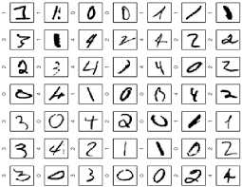
MNIST dataset loading
# MNIST Dataset
train_dataset = datasets.MNIST(root='./data/',
train=True,
transform=transforms.ToTensor(),
download=True)
test_dataset = datasets.MNIST(root='./data/',
train=False,
transform=transforms.ToTensor())
# Data Loader (Input Pipeline)
train_loader = torch.utils.data.DataLoader(dataset=train_dataset,
batch_size=batch_size,
shuffle=True)
test_loader = torch.utils.data.DataLoader(dataset=test_dataset,
batch_size=batch_size,
shuffle=False)
for batch_idx, (data, target) in enumerate(train_loader):
data, target = Variable(data), Variable(target)
...
https://github.com/yunjey/pytorch-tutorial

Slide 14
More dataset loaders are available
MNIST and FashionMNIST
COCO (Captioning and Detection)
LSUN Classification
ImageFolder
Imagenet-12
CIFAR10 and CIFAR100
STL10
SVHN
PhotoTour

Slide 15
Exercise 8-1:
Check out existing data sets (torch.vision)
Build DataLoader for
Titanic dataset: https://www.kaggle.com/c/titanic/download/train.csv
Build a classifier using the DataLoader

Slide 16


Lecture 9:
Softmax Classifier

